Slide 1
Risk Register
Description | Probability | Impact | Response Plan | Responsibility | Status
The new software for XYZ's client has faced an unexpected problem with compatibility and conformity.
3
3
Transfer the task of debugging software to another software developer team under close monitoring from the leader expert
Ryan Hernandez (Team Lead)
Danny Robinson (Software Architect)
Two Software Developers
Closed
Availability Resources . Insufficient resources for project. Shortage of technical supplies.
1
2
Contact third party vendor
Dawn Smith (Project Manager)
IT Director
Open
Management Risk.
1
4
Evaluate and develop a solution plan to address the administrative weaknesses of the Project Manager and his management team.
CEO of XYZ
Financial Director
Dawn Smith (Project Manager)
In progress
External Risk (Market’s rapid development)
2
2
Re-evaluate and develop a new plan to upgrade the software to outperform its competitors in the market.
Dawn Smith (Project Manager)
Danny Robinson (Software Architect)
Software Developers
Closed
Project scope expansion
3
4
Develop a new budget for the project to suit the emergency expansion.
CEO of XYZ
Financial Director
Dawn Smith (Project Manager)
Closed
Time is not estimated properly for the project
2
2
Reschedule a new timetable for the project to suit the unexpected scope expansion.
Dawn Smith (Project Manager)
Ryan Hernandez (Team Lead)
CEO of XYZ
Closed

Slide 2
STAKEHOLDER REGISTRY
PROJECT NAME
XYZ BUSINESS WORKFLOW
CLIENT
XYZ FINANCIAL SERVICES
PROJECT DESCRIPTION
CUSTOM SOFTWARE SOLUTION TO STREAMLINE SOME WORKFLOWS FOR THEIR WORLDWIDE OFFICES
NAME | ROLE IN PROJECT | POWER | INTEREST | TYPE | Influence on project outcome | NOTE
Dawn Smith | Project Manager | Low | High | Internal | Leading
Michael Lee | Software Architect | Low | Medium | Internal | Supportive
Danny Robinson | Technical Team Lead | Low | High | Internal | Supportive
UTI-1 (TBD) | User Interface Designer | Low | Medium | Internal | Supportive
UTI-2 (TBD) | User Interface Designer | Low | Medium | Internal | Supportive
Soft-Dev 1 (TBD) | Software Developer | Low | Medium | Internal | Supportive
Soft-Dev 2 (TBD) | Software Developer | Low | Medium | Internal | Supportive
Soft-Dev 3 (TBD) | Software Developer | Low | Medium | Internal | Supportive
Soft-Dev 4 (TBD) | Software Developer | Low | Medium | Internal | Supportive
Soft-Test 1 (TBD) | Software Tester | Low | Medium | Internal | Supportive
Soft-Test 2 (TBD) | Software Tester | Low | Medium | Internal | Supportive
MY-Boss | Project Director | Medium | Medium | Internal | Leading
Julia Smith | Product Manager | Low | High | Internal | Supporter
Ryan Hernandez | Team Lead | Low | Low | External | Supporter
IT (XYZ) | IT Director (XYZ) | High | Low | External | Neutral
(XYZ) Finance | Product Manager (XYZ) | High | Low | External | Neutral

Slide 3
WORK BREAKDOWN STRUCTURE
Designing
Developing 3 features
Customizing 5 features
Software test
The Project Director, Project managers and the UI Designer plus UI Developer in the company will set the principal points for developing the initial design and defining the primary frameworks' requirements for the project.
The team lead, product manager,
project manager,
and software architect
will generate
the framework for three new features
for XYZ's new software
the software testers
perform comprehensive and test
for the workability and the performance of the efficiency of their new software.
The team leads, the product manager,
the project manager, and the software architect
will set up initial points
to customize the developed five features
for the new XYZ software.
The software developers and testers team
customize and test feature one.
The team leads, the product manager,
the project manager, and the software recheck the new software
The software architect, the UI designer, and the software developer is to implement ABC workflow V3.0 to meet XYZ's requirements.
The software developer will create
feature one.
then the software tester will finalize it.
The software developers and testers team
customize and test feature two.
The Software tester will evaluate
& test the software initial design.
The software developer will create
feature two.
then the software tester will finalize it.
The software developers and testers team
customize and test feature three.
The IT director and project manager
will lead
the final review on
XYZ Business workflow 1.0 software.
The last step in this vertical hierarchy is the responsibility of the Product manager ,
and the Software Architect to approve the final UI Design, or send it back to be readjusted
The software developer will create
feature three.
then the software tester will finalize it.
The software developers and testers team
customize and test feature four.
The Product manager coordinates with the XYZ finance to get approval for the new software
The product manager and
the software architect
will assess the compatibility of
the new features
with the new UI.
The software developers and testers team
customize and test feature five.
The product manager, project manager,
and software architect check
features compatibility with the new UI.
The product manager & the
project manager will authorize the
release of the new product to the client.
The last step in this vertical hierarchy is the responsibility of the Product manager ,
and the Software Architect to approve the final developed features, or send it back to be readjusted
The product manager and the project manager,
and the software architect will approve
the final adjustment for
the new five vustomized features or send it back to be readjusted.

Slide 4
RACI’s chart
Client
Team Members
ABC Solutions
XYZ FINANCIAL SERVICES
External
Internal
Task/Delivered | CEO | IT Director | Ryan Hernandez Team Lead | Julia Smith Product Manager | Project Manager Dawn Smith | Michael Lee Software Architect | UI Developer | UI Designer | Software Developers | Software Testers
Requirements Analysis
C
C
R
R
R
R
I
I
I
I
Project managers and the UI Designer plus UI Developer in the company will the principal points for developing the initial design and defining the primary frameworks' based on the ABC workflow v. 3.0
I
C
R
R
R
R
I
I
I
I
The team leads, the product manager, project manager, and the
software architect will set up the framework to develop and customize the new
five features.
I
I
R
C
R
R
R
R
I
I
The team lead, product manager project manager,
and software architect will generate the framework for three new features
I
C
I
R
I
R
I
I
I
I
The software developers create new developed features (one to three)
I
I
I
I
A
I
I
I
R
I
The software testers check software developer work to send it for approval or send it back for review
I
I
I
I
C,I
I
I
I
I
R
and the Software Architect review and product manager approve the final developed features
I
I
I
A
I
R
I
I
I
I
The software developers team customize features one to five
I
I
I
I
A
I
I
I
I
I
The software testers team test the customized features one to five
I
I
I
I
C,I
I
I
I
I
R
the Product manager ,
and the Software Architect to approve the final developed features
I
C
I
A
I
I
I
I
I
R
The team leads, the product manager,
the project manager, and the software architect put the final review on the new software
I
I
R
R
R
R
I
I
I
I
The team leads, the product manager,
the project manager, and the software architect put the final review on the new software
I
I
R
R
R
R
I
I
I
I
The team leads, the product manager,
the project manager, and the software architect recheck the new software
C
I
R
A
I
R
I
I
I
I
The IT director and project manager
will lead final review on XYZ Business workflow 1.0 software.
C
R
I
I
A
I
I
I
I
I

Slide 5
1 week
3 weeks
6 weeks
6 weeks
4 weeks
3 weeks
1 weeks
Mar 7 – Apr 1
Apr 4 – May 20
May 23 – June 16
June 20- July 22
July 25 - 19 Aug
22 Aug – Aug 26
UI design & development
Feature Customization 1
Feature Customization 2
Feature Customization 3
Feature Customization 4
Feature Customization 5
START
Create framework for customizing 5 new features
Customize test
Customize test feature 2
Customize test feature 3
Customize test feature 4
Customize test & feature 5
Mar 1 – Mar 5
Requirement Analysis
Requirements Analysis
(Delivered by XYZ Business)
3 weeks
10 weeks
8 weeks
7 weeks
1 Week
Mar 7 – Apr 1
Apr 4 – June 17
June 20 – Aug 12
Aug 15 – Sep 2
Sep 5– Aug 12
Create framework for 3 new features
Create test for new feature 1
Feature 3 development
UI design & development
Feature 1 development
Create test for new feature 2
approval for customized 5 features & for developing 3 new features
Feature 2 development
Software System Testing
Create test for new feature 3
1 Day
END
1 Day
4 weeks
12 weeks
December 15
Sept 19 - Dec 14
September 15
August 15 – Sept 14
Fix, test debug
Finalize checking the XYZ Business workflow 1.1
Analyze performance of release 1. fix and finalize software for widespread deployment
Release 1
for XYZ Business workflow 1.0
Release preparation
Release 2
for XYZ Business workflow 1.1
Release preparation
Release
Release

Slide 6
XYZ Business Workflow
status report

Slide 7
Project Role and Objective
Objectives
GENERAL PROJECT INFORMATION PROJECT GOAL AND OBJECTIVES • Create a custom software solution to streamline workflows and processes across XYZ Financial Services’ locations. • Use the existing ABC Workflow v3.0 as the framework for the software solution. • Include three new features, customize five of the existing features, and redesign the user interface (UI). • Deliver XYZ Business Workflow v1.0 to two locations by 09/15/2021 (estimated). This version should include all requested features. • Deliver XYZ Business Workflow v1.1 to all locations by 12/15/2021 (estimated). This version will include all requested features.
1
2
3
4
5
6
Generate custom software solution
by using the existing ABC Workflow v3.0 as the framework
Develop
three new features
customize five of the existing features
design
a new user interface

Slide 8




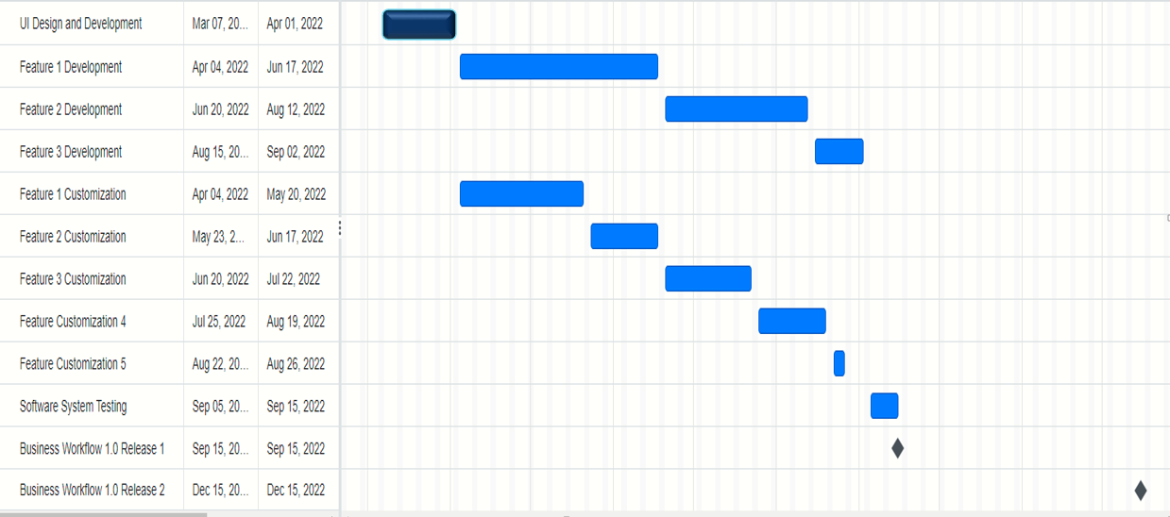
Initial Schedule with Milestones End Dates
2022
Requirement Analysis
Mar 01,22
Mar 04,22
1 Week
3 Week
10 Week
8 Week
7 Week
6 Week
6 Week
4 Week
3 Week
1 Week
1 Week
1 Week
1 Week

Slide 9
Week 10
Present Project Status, Accomplishment rate & Schedule Adjustment
2022
Requirement Analysis
Mar 01,22
Mar 04,22
Week 10
100%
Apr, 8, 22
100%
Apr 08, 22
Jun, 24, 22
10w+3d
65%
Jun 27, 22
Aug, 26, 2022
10 Week
0%
Aug, 29, 2022
Sep, 26, 2022
0%
Aug, 29, 2022
Aug, 29, 2022
90%
Aug, 29, 2022
Aug, 29, 2022
0%
Aug, 29, 2022
Aug, 29, 2022
5 Week
0%
Aug, 29, 2022
Aug, 29, 2022
0%
Aug, 29, 2022
Aug, 29, 2022
0%
Aug, 29, 2022
Aug, 29, 2022
1.5 Week
0%
Sep, 30, 2022
Sep, 30, 2022
0%
1.1 Release
0%

